Slide 1








Master – Slave replication ( Scaling for High Avilability )
Handling streaming Data from different sources
Using hash data type
Real Time Location tracking by REDIS
Slave-1
Port :6376
Read only
End user from US
US Streaming Data Producer
0100110101111010100001001001110010001011110
Master Server
Port :6379
Slave-2
Port :6377
0100110101111010100001001001110010001011110
Germany Streaming Data Producer
Write only
Read only
End user from Germany
010011010111101010000100100111001000101101110
Sample concept is Working
Slave-3
Port :6378
India Streaming Data Producer
Read only
End user from India
Master - Slave Cluster

Slide 2
Using Redis TRANSACTIONS (group of commands)
Queuing & Isolation of commands - ACID
Using List data type
Handling mismatch in “Add to cart” by REDIS
PIPELINING
reduce the latency
improve the number of operations per second on the server
Port :6379
I have some concept in mind.. Need to work on sample data

Slide 3
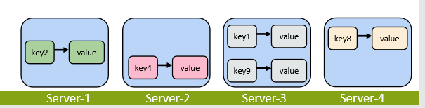
REDIS
ORDERS FROM SOURCE -2
ORDERS FROM SOURCE -3
ORDERS FROM SOURCE -1
ORDERS FROM SOURCE - 4
Port :6379
We can try some thing similar concept
Partinoning into different servers (each one for each supplier) . We are giving access to one supplier one server.

Slide 4
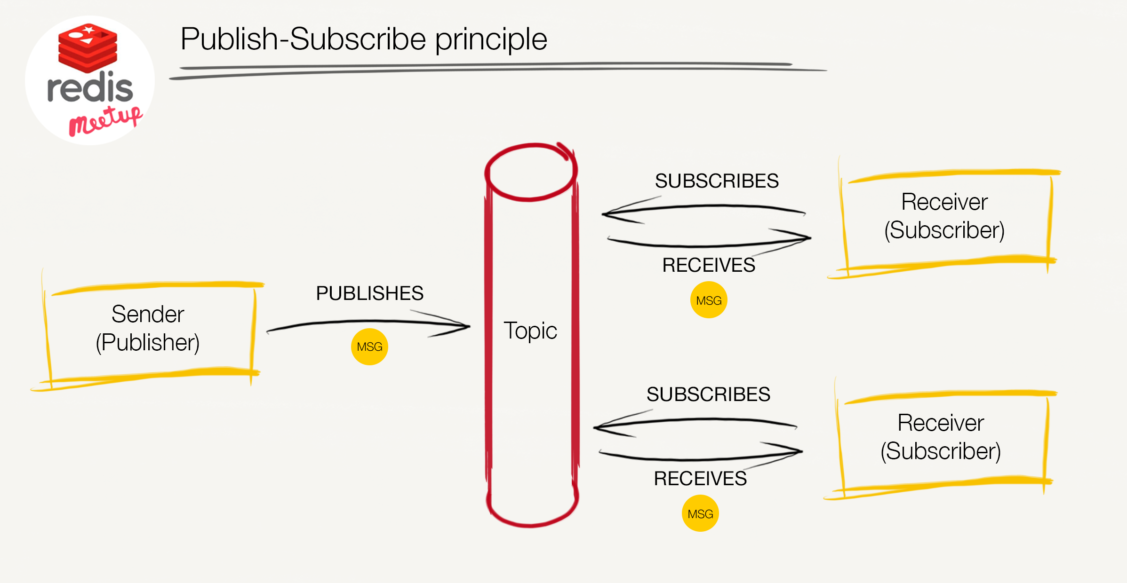
REDIS
Barabara told , NO to this pub-sub

Slide 5
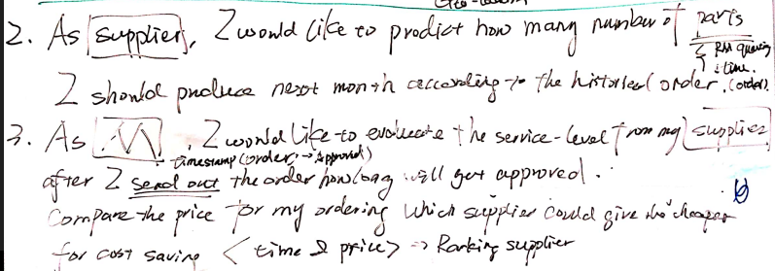
Demand forcasting :-
Neo4J
As Supplier, I would like to produce how many number of parts I should produce next month according to the historical data ?
Chelsea
Requried properties :- Quantity & Time stamp
It is linear regression

Slide 6
Neo4J
Ranking Entities :-
As Manufacturer, I would like to evaluate the service level from my suppliers, after I sent out the order how long will get approved. Compare the price per piece to my ordering which supplier could give the cheaper for cost saving.
Requried properties :- Quantity & Time stamp
It is linear regression
Naresh

Slide 7
Sentiment analysis of Reviews
NEO 4J
Anil
 | Review Good | Review Bad
High scale complaints
Low scale complaints

Slide 8
MongoDB
Please think of a user case in only MongoDB

Slide 9
MongoDB
Please think of a user case in only MongoDB

Slide 10
MongoDB
Please think of a user case in only MongoDB

Slide 11
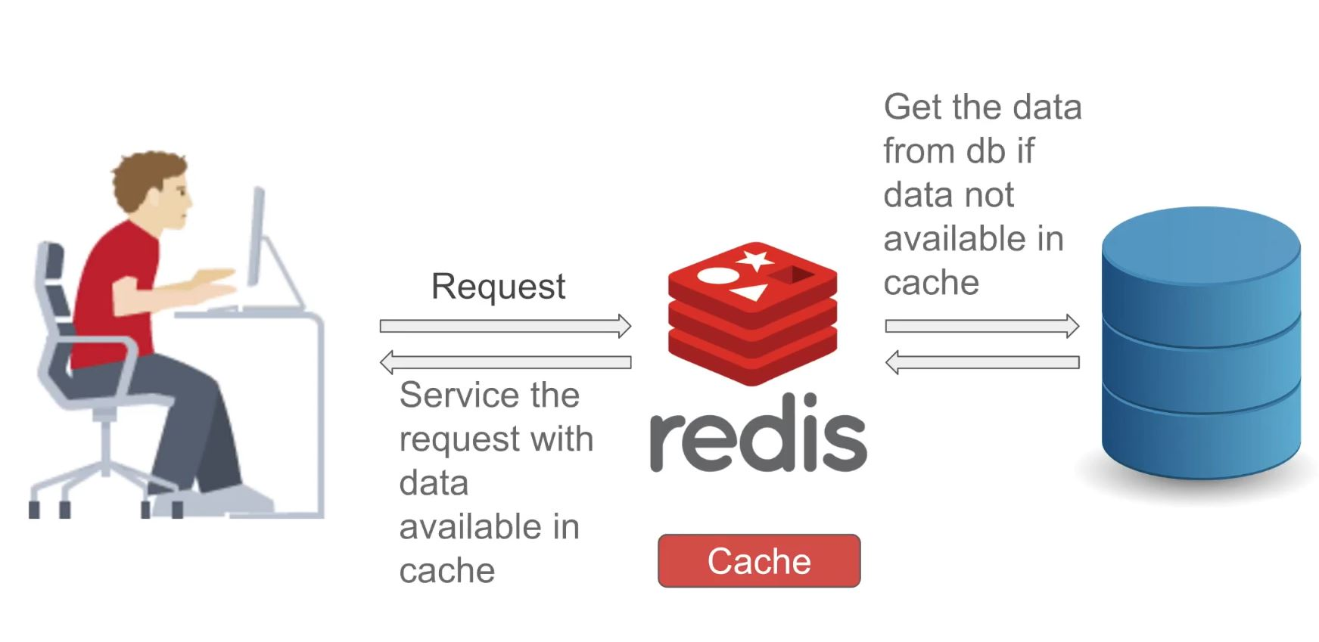
REDIS & Mongo
Snapshotting feature of Redis
MongoDB

Slide 12
Combination
Number of complaints
Total number of parts produced

Slide 13
Combination

